Slide 1
A National Survey of Bibliotherapy Practice in Professional Counseling
Dale-Elizabeth Pehrsson
& Paula McMillen
UNLV
American Counseling Association
March, 2009

Slide 2


Slide 3
Books have universal appeal and much to offer us…
  We are wired for stories
  We learn from stories
  We heal with stories

Slide 4
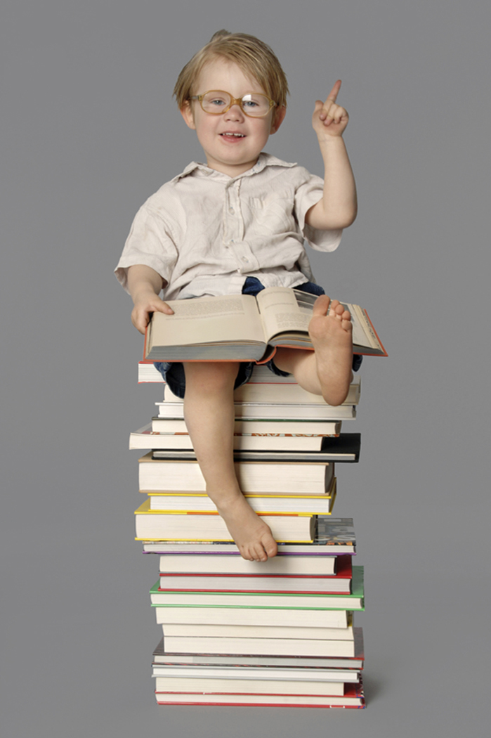
Bibliotherapy defined…

Slide 5
Literally… treatment through books
  (Pardeck & Pardeck, 1998)
Guided reading of written materials to help the reader grow in self awareness
  (Harris & Hodges, 1995)
Process of dynamic interaction between the personality of the reader and literature under the guidance of a trained helper
  (Shrodes, 1950)

Slide 6
Levels of Bibliotherapy
Developmental
  The use of literature and facilitative processes by skilled helpers to assist individuals in dealing with life transitions and normal developmental issues
Clinical
  The use of literature and facilitative processes by skilled mental health or medical practitioners in meeting specific therapeutic goals for the purpose of assisting individuals in dealing with severe disorders and traumatic life experiences
Notes:
Hebert & Kent (2000)
Kramer & Smith (1998)
Afolayan (1992)
Rubin (1978)
Mazza (2003)?

Slide 7
Benefits of Bibliotherapy
Increases empathetic understanding
  other cultures, viewpoints and lived experiences
Fosters appreciation of & identification
  one’s own ethnic/cultural identity
Increases self-awareness & clarifies emerging values
Stimulates discussion of feelings & ideas
Improves coping skills
  as alternative responses are explored
Reduces negative emotions
  stress, anxiety & loneliness
Enhances
  self-esteem, interpersonal skills & emotional maturity

Slide 8
Why this Survey?
Limited scope/scale of existing surveys
No standardized preparation, education or training in bibliotherapy
No standardized supervision or certification in bibliotherapy
Need for counselor educators to know current scope of practice by professional counselors

Slide 9
Previous Surveys
Atwater & Smith (1982)
Smith & Burkhalter (1987)
Starker (1986, 1988)
Matthews & Lonsdale (1991, 1992)
Quackenbush (1991)
Warner (1991)
Adams & Pitre (2000)
Notes:
Atwater & Smith (1982). Christian therapists' utilization of bibliotherapeutic resources. 99 members (34% response rate; Christian Association for Psychological Studies International ). Asked to determine the books and audiovisuals that would be endorsed as most helpful with a variety of problems in living.
Quackenbush, R. L. (1991). Surveyed 47 university counseling centers. Asked for recommendations of most useful self-help materials in 27 problem/concern areas. Created a bibliography.
Smith, D., & Burkhalter, J. K. (1987). Responses from 158 members of American Academy of Psychotherapists . (32% return rate on mailed survey). 51% used BT in practice. Utilization of BT increased with years in practice. Asked for titles used and effectiveness of titles for 10 specific problem areas (mostly situational, relationship/IP skills). Almost exclusively self-help.
Starker, S. (1986). Promises and prescriptions: Self-help books in mental health and medicine. Sought satisfaction ratings from 186 consumers, 105 psychologists, 97 psychiatrists, and 63 internists. 64.7% of the overall sample claimed to have read a helpful SH book. 88.6% of the psychologists, 58.8% of psychiatrists, and 85.7% of internists indicated that they prescribed SH books to their patients as a supplement to the treatment.
Starker (1988). Psychologists and self-help books: Attitudes and prescriptive practices of clinicians. Survey of 123 practicing psychologists in 36 states (membership of the National Register of Health Service Providers in Psychology; 30% response rate) concerning attitudes and prescriptive practices with regard to self-help books.
Warner (1991). Bibliotherapy: A comparison of the prescription practices of Canadian and American psychologists. 263 psychologists (Canadian Register of Health Service Providers in Psychology; 44% response rate), 63% responded affirmatively to prescribing self-help works to their clients/patients, with more than 100 books being recommended.
References
Adams, S. J., & Pitre, N. (2000). Who uses bibliotherapy and why? A survey from an underserviced area. Surveyed “all therapists in a northern Ontario community” (55% response rate to mailed & delivered survey). 68% of respondents use books mostly for self-help. Strong positive re’ship between length of clinical experience and use of books.

Slide 10
Research Methodology
Drafted project proposal and questions
Consulted with OSU Survey Research Center
Refined questions
Pilot tested survey
Secured funding to buy ACA mailing list
Sent three rounds of e-mail requests
Eliminated ‘undeliverables’ and spam filters
Summarized survey responses
Notes:
ACA list: 2000 randomly generated names
E-mails sent: Jan 15, 2008; Jan 24, 2008 (1st reminder to non-respondents, n = ca. 1500 valid e-mail addresses); Feb 4, 2008 (2nd reminder to non-respondents)
Archived “undeliverable” survey invitations (ca 400); handful of “please remove me from mailing list”; ca. 40-50 spam verifications
Final survey results n = 315

Slide 11
Research Questions
Demographics of respondents
  Personal and professional
Specific bibliotherapy practices
  Populations
  Presenting problems
  Implementation strategies
  Assessment approaches
  Book recommendations

Slide 20
Notes:
Q #24

Slide 21
Notes:
Q #25

Slide 22
Notes:
Q # 1

Slide 23
Notes:
Q #2

Slide 25
Notes:
Q #4
The predominant modes of cognitive behavioral & solutions focused are significant and consistent with findings that most used materials are self-help.

Slide 26
Notes:
Question # 5

Slide 27
Notes:
Q #6
% of respondants is vertical axis
% of clients with whom use BT on horizontal

Slide 28
Notes:
Q #14

Slide 29
Notes:
Q #15

Slide 32
Significant Findings for Age Groups:
67% of counselors report they use bibliotherapy (BT) with 19-25 year old clients more than 20% of the time
71% of counselors report they use BT with 26-40 year old clients more than 20% of the time
69% of counselors report they use BT with 41-60 year old clients more than 20% of the time
Only 20% of our sample reported working with the 2-7 year old & 81 or older age groups so BT usage was accordingly low

Slide 34
Significant Findings for Issues:
Counselors report using BT with more than 20% of their clients for the following categories of presenting issues:
  Grief and loss
  Social/life skills
  Trauma (abuse, catastrophic events)
  Family & couples’ issues
  Clinical diagnoses (depression, anxiety, etc.)

Slide 36
Significant Findings for Activities:
Most frequently used activities were
  Reading combined with writing activity
  Assigning independent reading
  Reading to or with the client
Least used activities included
  Use in classrooms or guidance units
  Group therapy readings
  Reading accompanied by art or drama activity

Slide 37
Notes:
Q #12

Slide 38
Significant findings for Materials:
Most commonly used materials for BT were:
  Self-help materials or readings
  Workbooks
  Informational pamphlets
Least used materials were :
  Poetry
  Audio books
  Fiction
  Picture books

Slide 39
Notes:
Q #17

Slide 40

Research
Limitations
Getting a viable sample from e-mailing list
Self-selected respondents
Those who selected out of survey
Possible social desirability response bias
Some possibilities of duplicate reporting within questions (“Other” category)
Difficult to assess actual preparation that individuals obtained

Slide 41
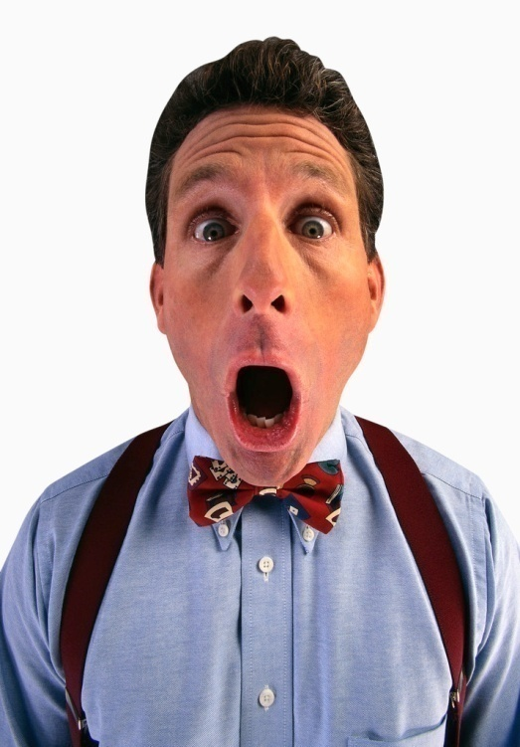
Survey Surprises
Limited use of imaginative literatures (e.g., poetry, picture books, fiction)
Limited intervention approaches (e.g., few use with classroom guidance)
Some populations/ issues not targeted (e.g., academic issues, children & elders)
Few rely on librarians as source of recommendations!
Notes:
But we did not survey ASCA

Slide 42
Conclusions
Based on the populations served (adults aged 19-60 years) and the therapeutic orientations (cognitive behavioral, 53%, & solution-focused, 36%) of our sample, it is not surprising that the predominantly used materials are non-fiction (self-help, workbooks, informational pamphlets).
We believe that fiction & imaginative literature are not adequately recognized or used.

Slide 43

More to do….
Target practitioners who use creative interventions for comparative survey data
    Association for Creativity in Mental Health
    American School Counselor Association
    Association for Play Therapy
    Association of Poetry Therapy
Enhance the evaluation components in Bibliotherapy Evaluation Tool for
    Non-fiction
    Informational
    Self-help books
    Manualized treatment texts

Slide 44

Implications for
Counselor Educators

Slide 45
Counselors do use bibliotherapy as a part of their professional practices
Their preparation takes place to a large degree as part of academic course work or at workshops
Many are self taught
Counselors in training need grounded preparation because this is a common set of therapeutic interventions

Slide 46
Recommendations for Counselor Preparation
Specific bibliotherapy education unit embedded within curriculum that includes:
  Historical practices of bibliotherapy
  Research on effectiveness of bibliotherapy
  Client assessment and treatment planning
  Intervention options and strategies
  How to analyze and select appropriate literature
  How to assess client progress
  Ethical considerations and practice cautions
  How to find therapeutically relevant resources—including calling on the expertise & resources of local libraries (children and adult librarians)
  Emphasize the value of imaginative literature & picture books for bibliotherapeutic applications

Slide 47
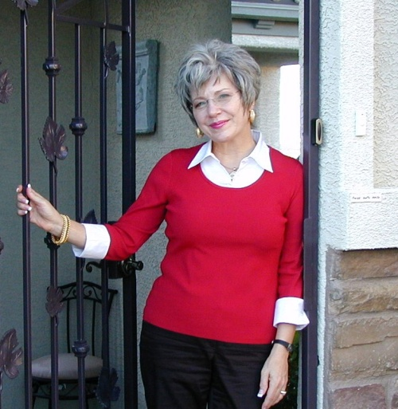
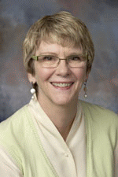
Thank you!
For questions or future communication contact either:
Dr. Dale-Elizabeth Pehrsson at
dale.pehrsson@unlv.edu
Dr. Paula McMillen at
paula.mcmillen@unlv.edu
Bibliotherapy Education Project website:
http://www.library.unlv.edu/faculty/research/bibliotherapy/

